Slide 1
DIFFUSION MR
SUBMITTED BY:
Mostafa Amr
Mostafa Abd El-Mohsen
Adel Refaat
Kirolos Dawood

Slide 2
Agenda Layout
1
DIFFUSION
2
Diffusion Weighted Image
3
Pulse Sequences For DWI
4
Diffusion Tensor Imaging
5
DW Images Steps
6
Apparent Diffusion Coefficient
7
DWI Deficiencies
8
Artifacts
9
Technological Advancement In Addressing The Challenges
10
The Advantages Of DWI

Slide 3

Diffusion
What is diffusion ?

Slide 4
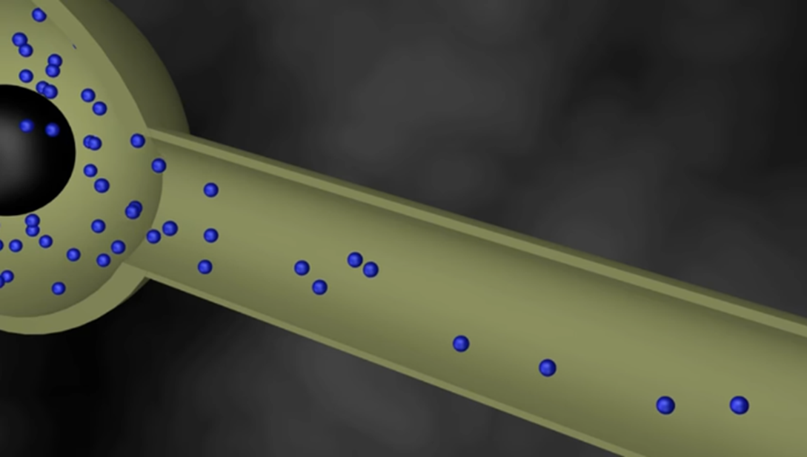

Diffusion
Diffusion relates to the unexpected microscopic motion of water and
other small molecules relying on
the microscopic structural conditions in the tissues

Slide 5
Diffusion weighted image
DWI

Slide 6
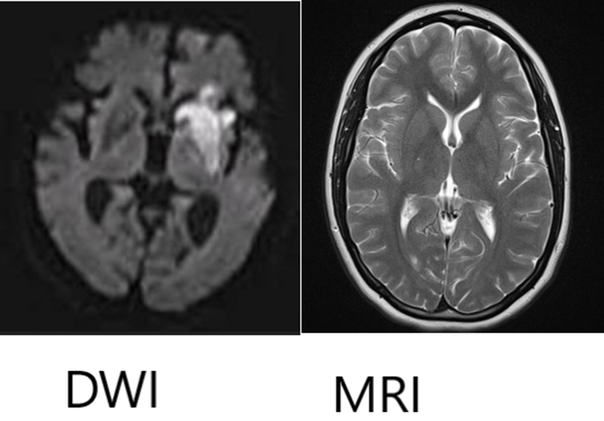
DWI objective
The water diffusion can be detected or measured using the diffusion-
weighted imaging (DWI) technology.
DWI is sensitized to the water
molecular motion in tissue by
applying magnetic field gradients
(diffusion gradients) in the RF pulse sequence.

Slide 7
DWI objective
In a DWI sequence, the diffusion
weighting is determined by a
parameter called “b-value,” which is in the unit of second per square
millimeter (s/mm2).
High “b-value” generates high
diffusion weighting.

Slide 8
PULSE SEQUENCES FOR DWI

Slide 9

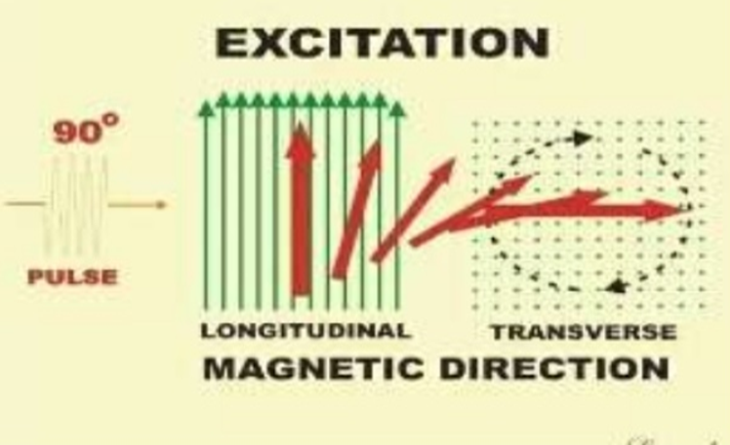
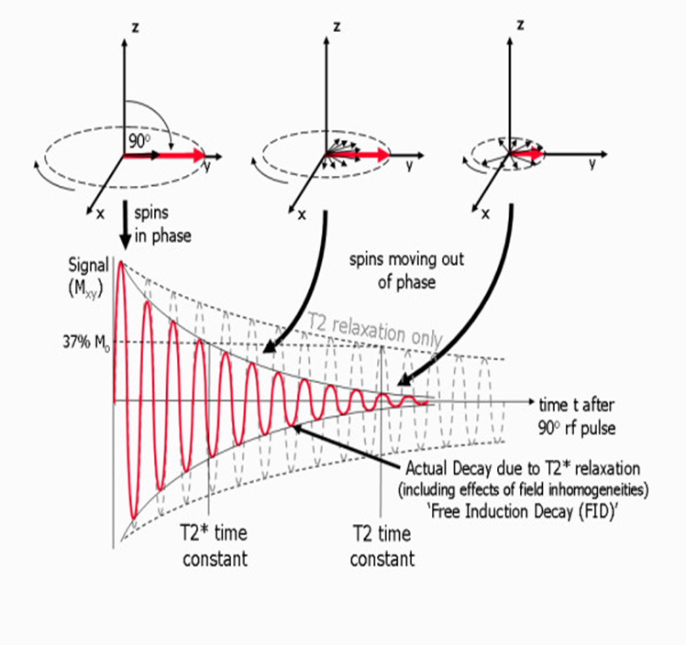
PULSE SEQUENCES FOR DWI
90° RF pulse

Slide 10
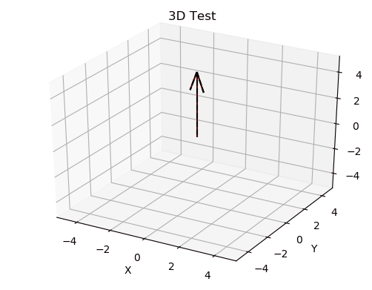

PULSE SEQUENCES FOR DWI
90° RF pulse

Slide 11
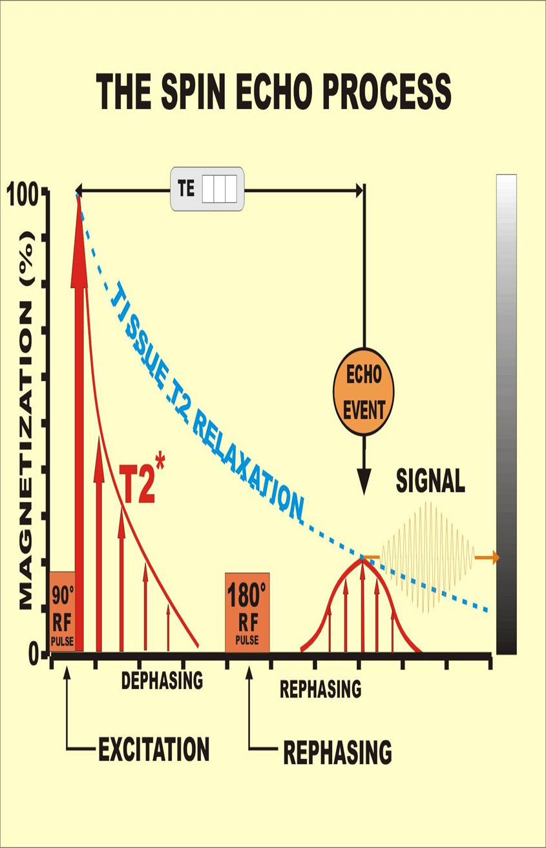
PULSE SEQUENCES FOR DWI
pulsed gradient spin echo (PGSE)

Slide 12
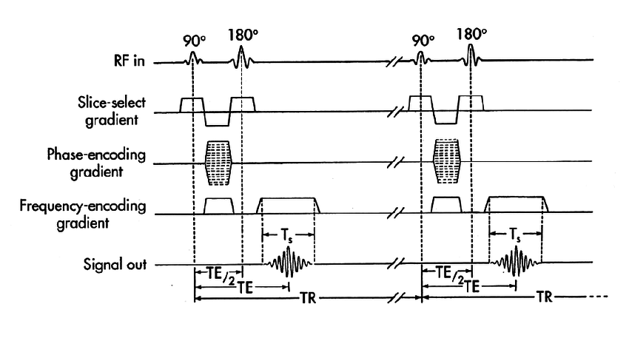
PULSE SEQUENCE

Slide 13
Diffusion Tensor Imaging
DTI

Slide 14

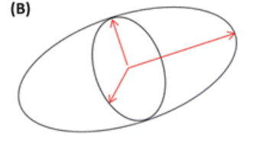
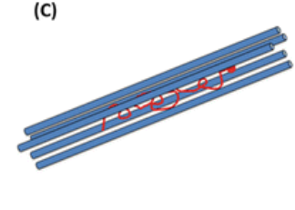
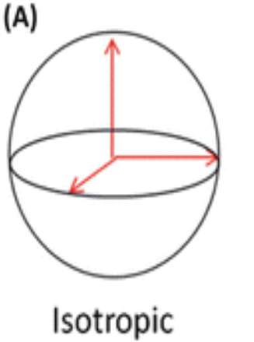
Diffusion Tensor Imaging (DTI)
DTI is an extension of DWI. Diffusion is a three-dimensional process
If water molecule movement is restricted in certain
directions
In a uniform
environment
in fiber-like cell structures
Isotropic
Anisotropic

Slide 15
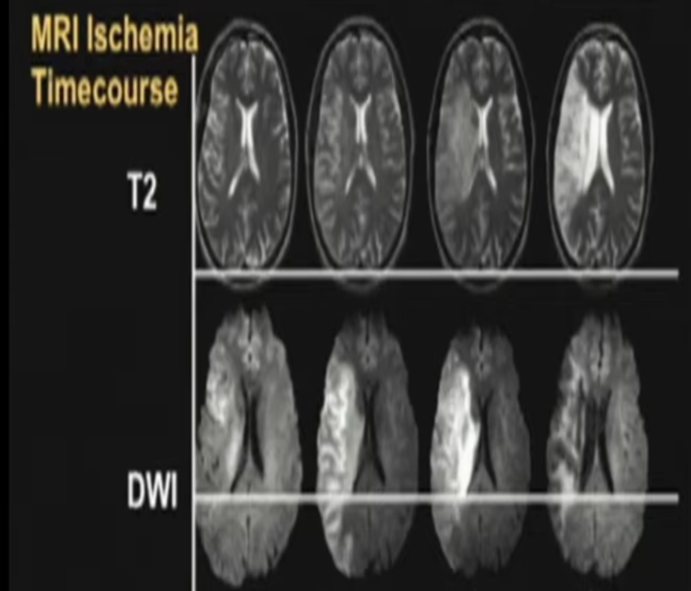
The difference between DWI and conventional MRI
Fast diagnose of stroke

Slide 16
DW images steps

Slide 17
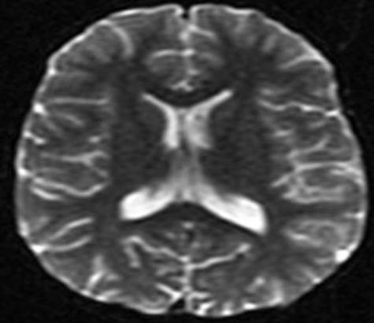
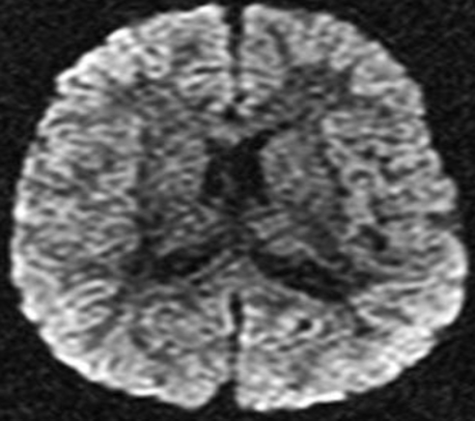
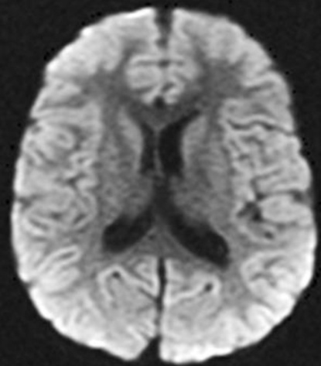
DW images steps
B0 IMAGE
DW Source IMAGE
Trace DW IMAGE
The DW pulse sequence is initially executed with the DG turned off or set the value to very low. This generates a set of T2-weighted b0
("b-zero") images
The DW sequence is then executed individually or in combination with the DG's turned on and at different strengths

Slide 18
Apparent diffusion coefficient
ADC

Slide 19
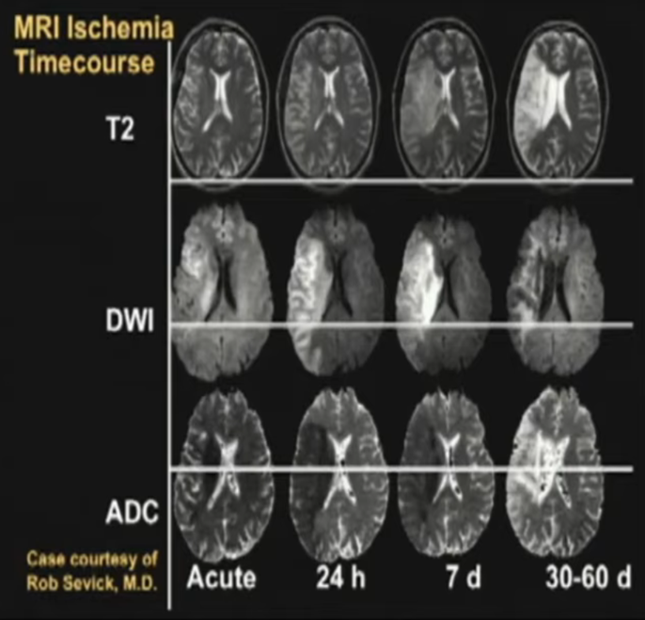

(ADC) map
ADC map, is an MRI image that more
specifically shows diffusion than conventional DWI, by eliminating the T2 weighting that
is otherwise inherent to conventional DWI.
ADC imaging does so by acquiring multiple
conventional DWI images with different
amounts of DWI weighting, and the change
in signal is proportional to the rate of diffusion

Slide 20
DWI Deficiencies

Slide 21
DWI Deficiencies
Unfortunately practically the image of DWI depends on a lot of factors which may reduce its efficiency like:
The field homogeneity
Slow gradient changes
The hardware limitations

Slide 22

DWI Deficiencies
DW images tend to be of lower resolution than conventional MR images such as T2WI. This is due to multiple factors such as:
low resistance scanners
faster image acquisition methods such as:
Single-Shot Echo Planar Imaging

Slide 23
Artifacts

Slide 24
Artifacts
Distortion is one of the biggest artifacts in DW images.
Distortion of the images may occur due to field inhomogeneity and magnetic
susceptibility variations in the area.

Slide 25
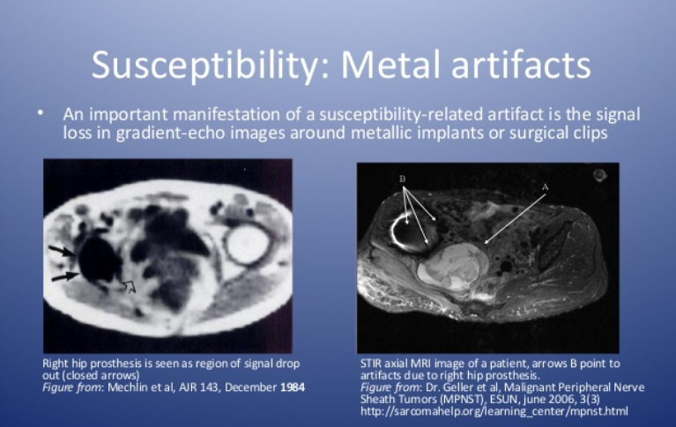
Susceptibility: Metal artifacts
An important manifestation of susceptibility-related artifacts is the signal loss in
gradient-echo images around metallic implants or surgical clips.
Right hip prosthesis is seen as region of signal drop out (closed arrows)
STIR axial MRI image of a patient,
arrows B point to artifacts due to right hip prosthesis

Slide 26
Technological advancement in addressing the challenges

Slide 27

Technological advancement in addressing the challenges
DW images often have lower image quality compared to other traditional MR-
images due to problems with image quality such as :
distortion
noise
poor resolution

Slide 28
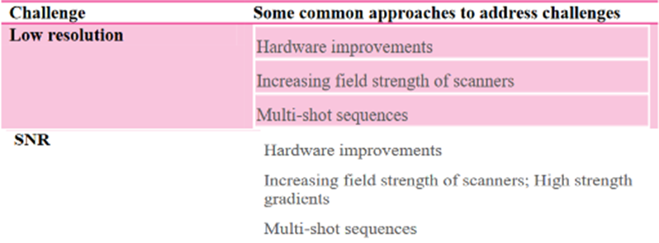
Technological advancement in addressing the challenges
Most of these problems can be solved by altering DW-MR protocol variables
such as:
echo time (TE)
gradient strengths
adjusting techniques for image acquisition Technological advancement in addressing the challenges

Slide 29
The advantages of DWI

Slide 30

Advantages of DWI
DWI may be useful to demonstrate persistent or progressive tumor despite the lack of contrast enhancement.
DW-MRI is applied in neoplasms of the neck and head.
DWI can differentiate benign renal cysts easily from solid neoplasms.

Slide 31
Advantages of DWI

Slide 32
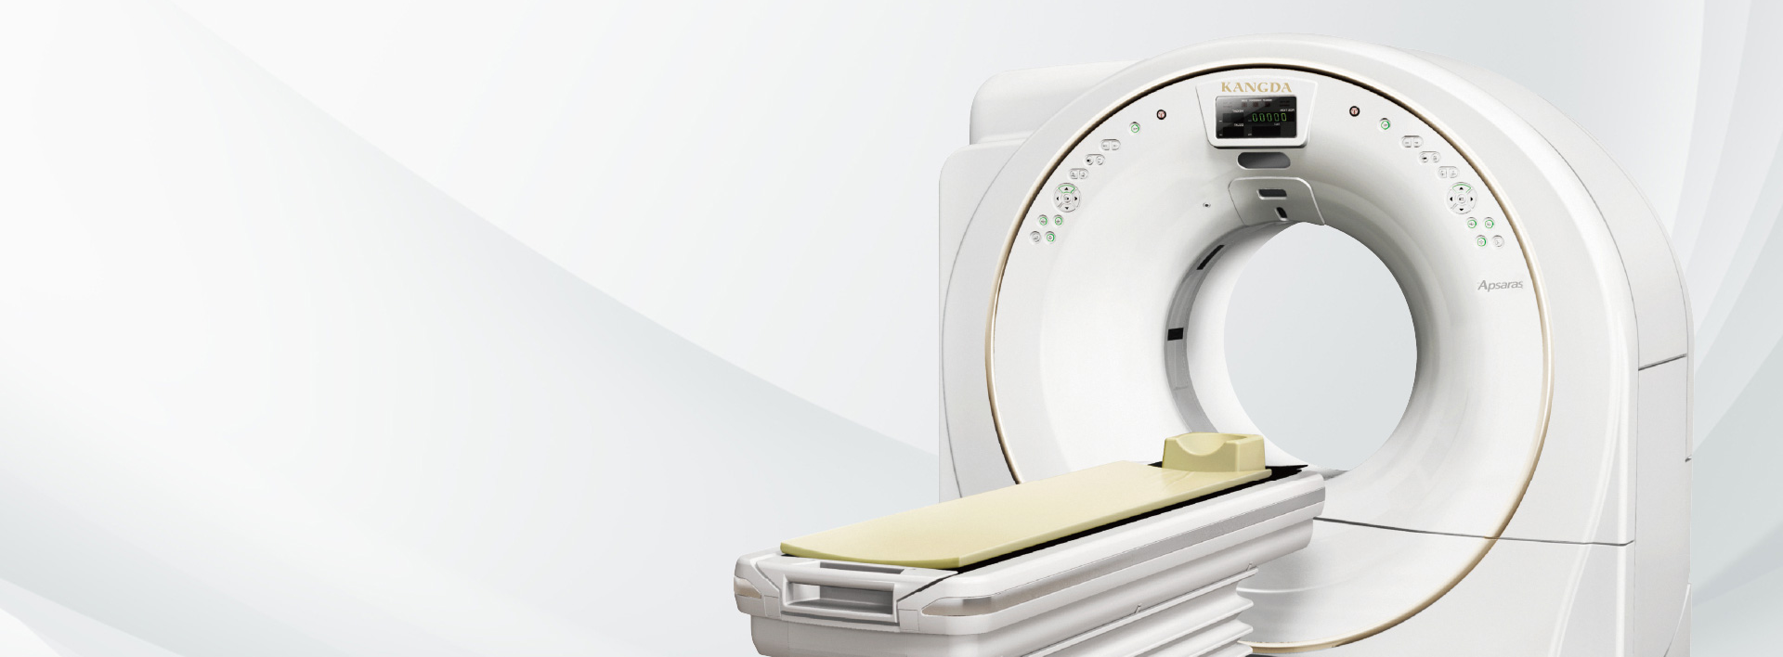
Thank you

